Slide 1
Recurrent Neural Networks Tutorial
Reza Marzban

Slide 2
Main concept
Recurrent networks, unlike fully connected networks, take as their input not just the current input example they see, but also what they have perceived previously in time.
RNNs can use their internal state (memory) to process sequences of inputs.
The sum of the weight input and hidden state is squashed by the activation function.

Slide 3

Main Concept

Slide 4
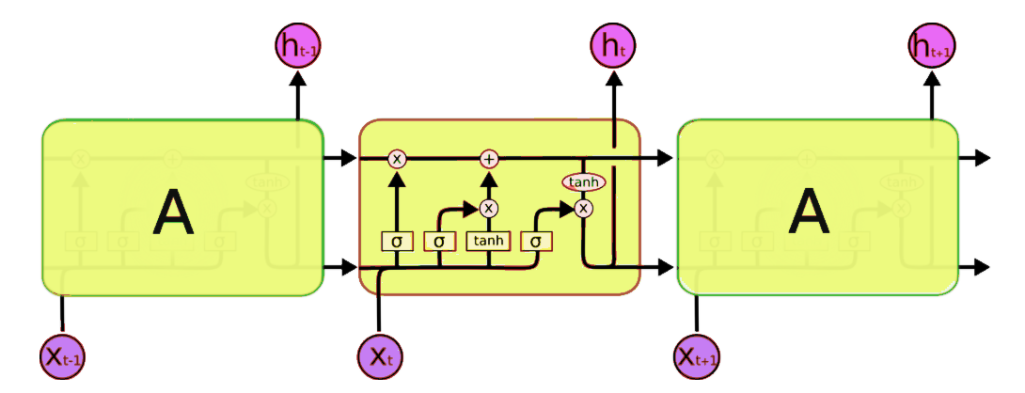
Long Short Term Memory
LSTMs contain information outside the normal flow of the recurrent network in a gated cell.
Information can be stored in, written to, or read from a cell, much like data in a computer’s memory.
The cell makes decisions about what to store, and when to allow reads, writes and erasures, via gates that open and close.

Slide 5
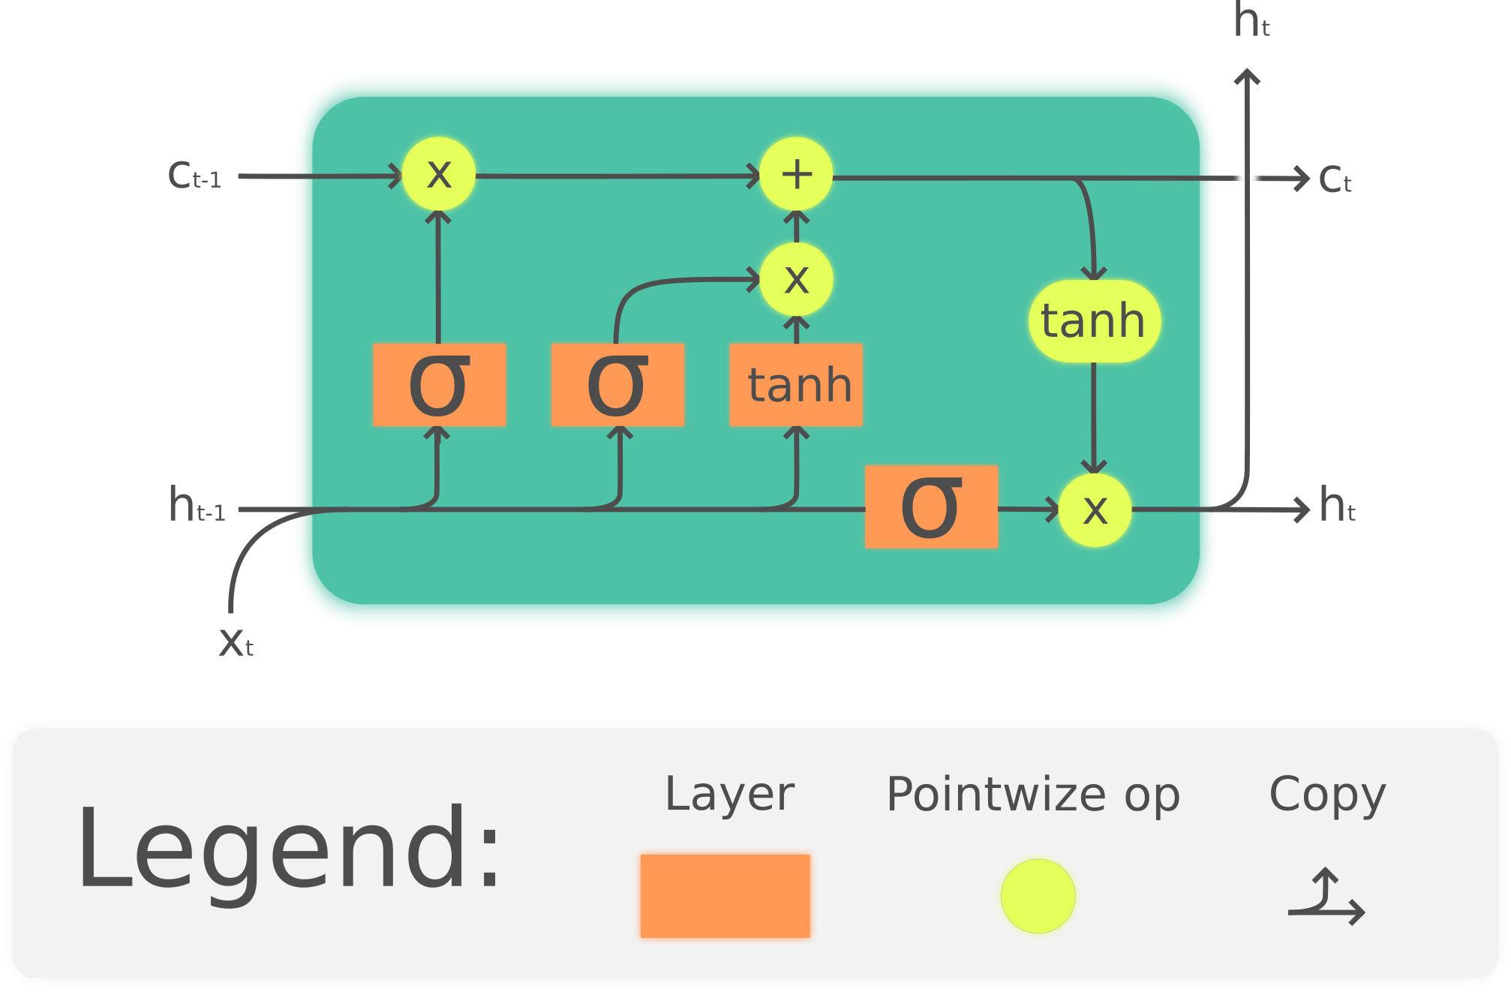
Long Short Term Memory

Slide 6
LSTM gates
Forget Gate
Controls what information to throw away from memory.
Input Gate
Controls what new information is added to cell state from current input.
Output Gate
Conditionally decides what to output from the memory.

Slide 7
Use Cases
Analysis of any kind of time series data:
One-to-Many: An observation as input mapped to a sequence with multiple steps as an output. (e.g. picture captioning)
Many-to-One: A sequence of multiple steps as input mapped to class or quantity prediction. (e.g. sentiment analysis)
Many-to-Many: A sequence of multiple steps as input mapped to a sequence with multiple steps as output. (e.g. chatbot, translation)

